Slide 1
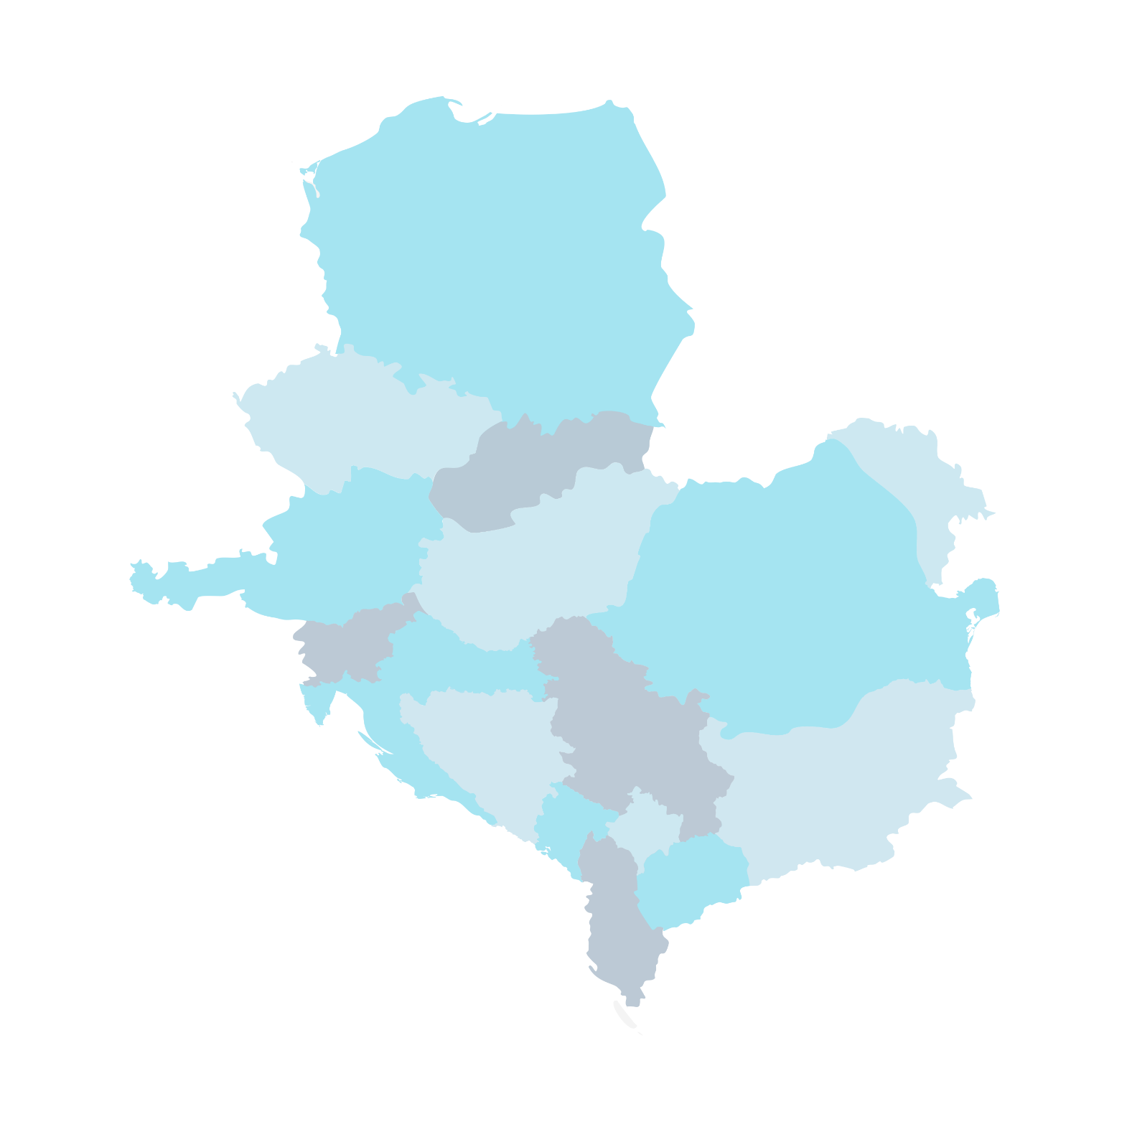



CEEPUS
CENTRAL EUROPEAN EXCHANGE PROGRAM
FOR UNIVERSITY STUDIES
Scholarship for students and teachers in Central Europe or in the Western Balkans
Tempus Public Foundation / National CEEPUS Office Hungary
ceepus@tpf.hu

Slide 2
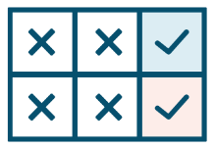









Why CEEPUS?
simple application
international experience
nearby
courses in English,
German,
etc.
expanding resources
opportunity to move on to other applications
mobility outside the networks
diverse
disciplines
exciting
summer schools
fosters
credit recognition
(mobility window)
expanding courses in foreign languages,
guest lecturers
short term mobility
professional and personal networking
available from non-EU countries

Slide 3



CEEPUS is an excellent opportunity for all!
”For the Hungarian University of Agriculture and Life Sciences, CEEPUS has resulted in a joint master's program in one of our networks, which has been operating for more than 20 years. Our graduate students have a unique opportunity to participate in short term mobility, which is not available in other programmes or very difficult to access.”
Dr. Zsuzsanna Tarr
institutional CEEPUS coordinator, HUALS
”CEEPUS scholarships open the horizons for our students and faculty staff to countries we do not necessarily know enough about. In addition to the classical semester mobilities, they also provide an excellent opportunity to gain short-term professional experience. Incoming teachers and students add colour to our academic year and provide useful information about their country, that can be of great value to future engineers.”
Prof. Dr. József Gál
vice-dean, University of Szeged
”CEEPUS is a unique highlight in the life of the university and in its internationalization efforts. The program features an unparalleled shared experience in Central, Eastern and Southern Europe, that has joined colleagues from countries with similar history and destiny. Summer schools and coordination meetings also serve to nurture this relationship.”
Edit Szőke
institutional CEEPUS coordinator, University of Miskolc

Slide 4
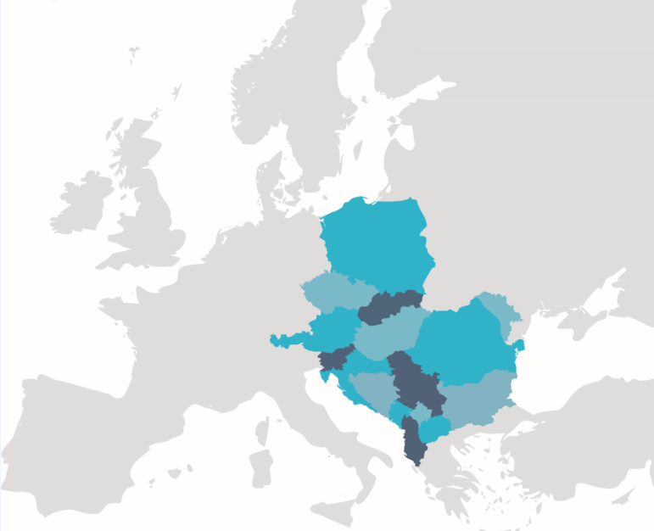
The CEEPUS program is available in
Albania
Austria
Bosnia and Herzegovina
Bulgaria
Czech Republic
North Macedonia
Croatia
Kosovo
Poland
Hungary
Moldova
Montenegro
Romania
Serbia
Slovakia
Slovenia

Slide 5
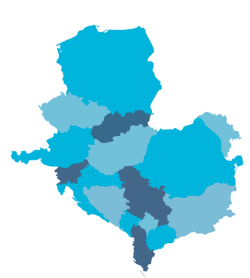

General
INFORMATION
resource: scholarship is funded by the host country up to the quota offered annually by the ministry responsible for education
scholarship is paid by the host country to incoming grant holders
scholarship rates differ in each country for outgoing grant holders

Slide 6

General
INFORMATION
online application: ceepus.info platform
Mobility within a network: no documents required
Freemover mobility: Teacher’s Letter
5 working days with min. 6 teaching/ supervising hours
(= 1 scholarship month in the ceepus.info application system)
research activity or conference visit can supplement a teacher mobility but cannot be the only aim of it!

Slide 7
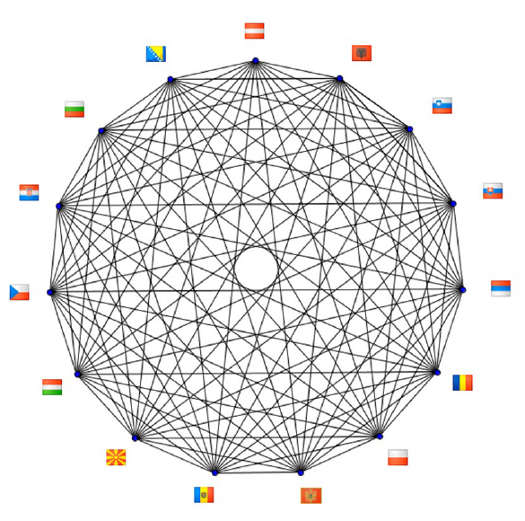

What is a
CEEPUS NETWORK?

Slide 8


What is a
CEEPUS NETWORK?
min. 3 higher education institutions from 3 countries
long-term international, thematic cooperation
smaller units (e.g. faculties or departments) of the partner institutions
student and teacher mobilities can be implemented between partners in a network
thematic cooperation:
  disciplinary
  multidisciplinary

Slide 9

Conditions of Cooperation in a
NETWORK
exemption from tuition fee at the host higher education institution
mutual recognition of studies abroad (not compulsory but recommended to use: Learning Agreement,
Transcript of Records)
use of ECTS or a compatible credit system
courses in English/German/French for incoming students

Slide 10


Eligible
ACTIVITIES
mobility type
duration
relations
Study period (BA, MA, PhD) | 3-5 months | Network Freemover
Short term mobility > research, consultation related to thesis/dissertation (BA, MA, PhD) | 1-2 months | Network Freemover
Short term excursion (BA, MA, PhD) | 3-5 days | Network
Teacher mobility | min. 5 working days and 6 teaching hours | Network Freemover
Summer school BA, MA, PhD and Teachers | min. 6 days | Network Freemover
Coordination meeting Teachers | 2-3 days | Network Freemover
research activity cannot be the only aim!

Slide 11


SUBMISSION DEADLINES
Network application
15 January
Mobility applications within a network
(outgoing/incoming)
winter semester (1 Sept - 31 Jan): 15 June
summer semester (1 Feb - 30 June): 31 October
Freemover mobility applications
1 July – 30 November
Deadlines are on the same days each year.

Slide 12


CEEPUS
firsthand information
ONLINE
ceepus.hu/en
ceepus.info

